Slide 1

Data Science Committee
Session 04 - Planets with pandas & matplotlib
Prepared by: Ashraf Abdulkhaliq

Slide 2
Outline
Tools
Importance of High Quality Data
Handle Missing Values
Choosing the Right Imputation Method
Lab

Slide 3
Outline
Tools
Importance of High Quality Data
Handle Missing Values
Choosing the Right Imputation Method
Lab

Slide 4

Tools
Science kit learn
Scikit-learn (Sklearn) is the most useful and robust library for machine learning in Python.
It provides a selection of efficient tools for machine learning and statistical modeling including classification, regression, clustering and dimensionality reduction via a consistence interface in Python.
This library, which is largely written in Python, is built upon NumPy, SciPy and Matplotlib.

Slide 5
Outline
Tools
Importance of High Quality Data
Handle Missing Values
Choosing the Right Imputation Method
Lab

Slide 6
Importance of High Quality Data
Accurate Decision-Making: High-quality data leads to more accurate and informed decision-making.
Accurate Insights: Data quality ensures that the insights derived from data analysis are reliable and precise.
Reduced Risks: Poor-quality data can result in poor decision-making, exposing businesses to financial and reputational risks.
Cost Savings: Using high-quality data in data analytics reduces the potential for wasted resources and efforts.
Improved Customer Experience: Data quality is crucial for enhancing the customer experience through personalized marketing and engagement strategies.

Slide 7
What does good data quality look like?
Accuracy: Accurate data is free from errors and reflects the real-world entities and events it represents.
Uniqueness: Good data quality ensures that there are no duplicate entries in the dataset. This uniqueness helps maintain data cleanliness and precision.
Completeness: Contains all the necessary information required for its intended use. It lacks gaps, missing values, or omissions.
Consistency: Involves maintaining a uniform format throughout the dataset. Data entries should follow the same standards and formatting conventions.
Validity: Valid data adheres to the constraints and rules established for its use. It satisfies criteria such as range, format, and domain constraints.

Slide 8
How to improve data quality (Data Cleaning)
Data profiling (EDA, ...)
Handle missing values
Handle duplicate values
Clean incorrect data
Standardize data (formats, units, ...)
Detect and handle outliers
Iterate and validate

Slide 9
Outline
Tools
Importance of High Quality Data
Handle Missing Values
Choosing the Right Imputation Method
Lab

Slide 10
Handle Missing Values
Removal of missing data (list when it's appropriate).
Mean, median, and mode imputation.
Forward and backward fill imputation.
Regression imputation.
K-Nearest Neighbors (K-NN) imputation.
Multivariate imputation by chained equations (MICE)

Slide 11
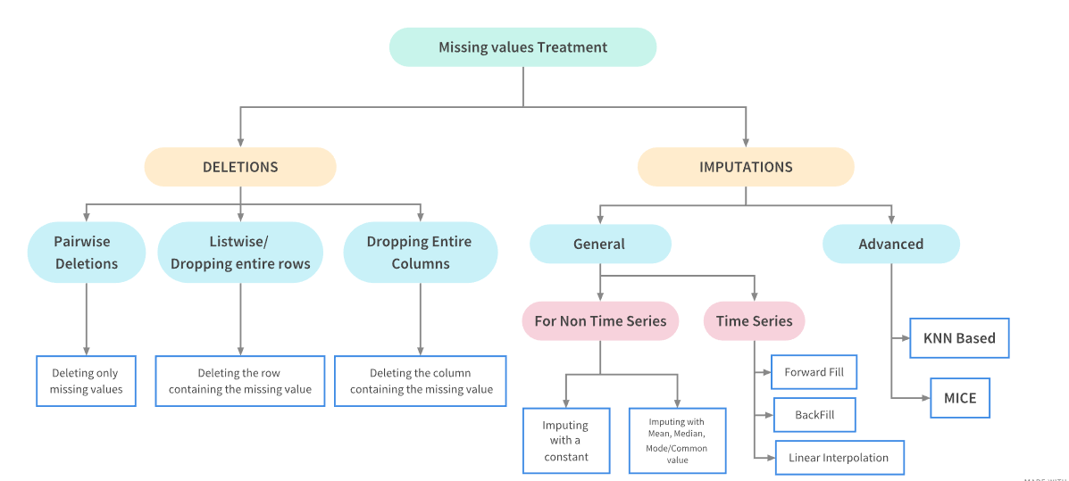
Handle Missing Values

Slide 12
Removing Missing Data
Removal of missing data involves eliminating rows or columns with missing values from the dataset.
Appropriate when:
Missing data is rare and does not significantly affect the analysis.
Removing missing data does not lead to a loss of critical information.
There is no other imputation methods available to fill the gaps.
Caution: Use this method sparingly, as it can lead to loss of information and potential bias if not done thoughtfully.

Slide 13
Mean, Median, and Mode Imputation.
These imputation methods involve replacing missing values with the mean, median, or mode of the available data in the respective column.
Appropriate when:
Data is approximately normally distributed.
Missing values are missing at random and not related to the value itself.
The imputed values do not significantly alter the data distribution.
Quick and simple, but can introduce bias if the data is not normally distributed.

Slide 14
Forward and Backward Fill Imputation
Forward fill imputation: replaces missing values with the nearest available value that precedes the missing data.
Backward fill imputation: uses the nearest available value that follows the missing data.
Appropriate when: handling time series data where values are dependent on their chronological order.

Slide 15
Regression Imputation
Regression imputation involves building a regression model to predict missing values based on relationships with other variables.
Appropriate when:
Data exhibits strong relationships or correlations.
The missing values are not completely random.
More advanced imputation techniques are needed to capture complex relationships.
It can provide accurate imputations when relationships are well-defined.

Slide 16
K-Nearest Neighbors (K-NN) Imputation
K-NN imputation replaces missing values with values from the nearest neighbors in a multidimensional space.
Appropriate when:
Data has complex relationships.
You want to consider multiple attributes when imputing values.
The dataset is not too large, as k-NN can be computationally intensive.
It takes into account the context of the data, making it suitable for a variety of situations.

Slide 17
Multivariate Imputation by Chained Equations (MICE)
It involves imputing missing values for each variable in a dataset one at a time, in a sequence, while considering the relationships with other variables.
Appropriate when:
Missing data is not missing completely at random and when univariate imputation methods may not capture complex data patterns.
Suitable for datasets with complex dependencies and interactions between variables.

Slide 18
Outline
Tools
Importance of High Quality Data
Handle Missing Values
Choosing the Right Imputation Method
Lab

Slide 19
Choosing the Right Imputation Method
Understand Your Data: Consider the type of variables (numerical, categorical, time series) and their distributions.
Assess Missing Data Patterns: Examine the patterns of missing data. Are the missing values missing completely at random, or missing not at random?
Consider Data Type:
For numerical data, methods like mean, median, mode imputation or regression imputation may be suitable.
For categorical data, consider using mode imputation, k-Nearest Neighbors (k-NN) imputation, or other methods tailored to categorical variables.
For time series data, forward and backward fill imputation or time series modeling may be appropriate.

Slide 20
Choosing the Right Imputation Method
4. Evaluate Data Distribution: If your data is highly skewed or has outliers, be cautious about using mean imputation, which can be sensitive to extreme values
5. Examine Data Relationships: If your dataset has strong correlations or dependencies between variables, methods like regression imputation or k-Nearest Neighbors (k-NN) may be more appropriate.
6. Think About Sample Size: If your dataset has a large number of missing values for a particular variable, simple imputation methods like mean imputation may be less accurate. In such cases, more advanced imputation methods, such as regression or k-NN, can yield better results.

Slide 21
Outline
Tools
Importance of High Quality Data
Handle Missing Values
Choosing the Right Imputation Method
Lab

Slide 22
Lab
Open Juypter Notebooks for session 04 to cover this topics in practice:
Recap on SQLite
Data exploration using pandas.
Data visualization using matplotlib.
Handle missing values

Slide 23
References
https://www.linkedin.com/pulse/importance-data-quality-analytics-brittsimperial/
https://www.sagacitysolutions.co.uk/about/news-and-blog/what-is-data-quality/
https://www.kaggle.com/code/parulpandey/a-guide-to-handling-missing-values-in-python?scriptVersionId=38521662

Slide 24
Thanks
Please keep updated:
https://github.com/kershrita/IEEE-Data-Science

